Slide 1
'As open as possible, as closed as necessary'
Southern Federal University
Mark Hahnel, CEO

Slide 3
Some context

Slide 4
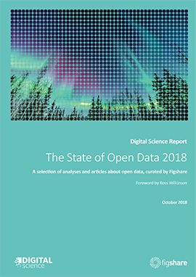
Key results:
64% of respondents revealed they made their data openly available in 2018, a 7% rise on 2016.
Data citations are motivating more respondents to make data openly available, increasing 7% from 2017 to 46%.
The percentage of respondents in support of national mandates for open data is higher at 63% than in 2017 (55%).
Respondents who revealed that they had reused open data in their research continues to shrink. In 2018, 48% said they had done this, whereas in 2017, 50% had done so, with 57% in 2016.
Most researchers felt that that they did not get sufficient credit for sharing data (58%), compared to 9% who felt they do.
Respondents having lost research data has decreased from 2017 (36% versus 30% in 2018).
https://doi.org/10.6084/m9.figshare.7195058.v1
Notes:
Figshare open data survey

Slide 5
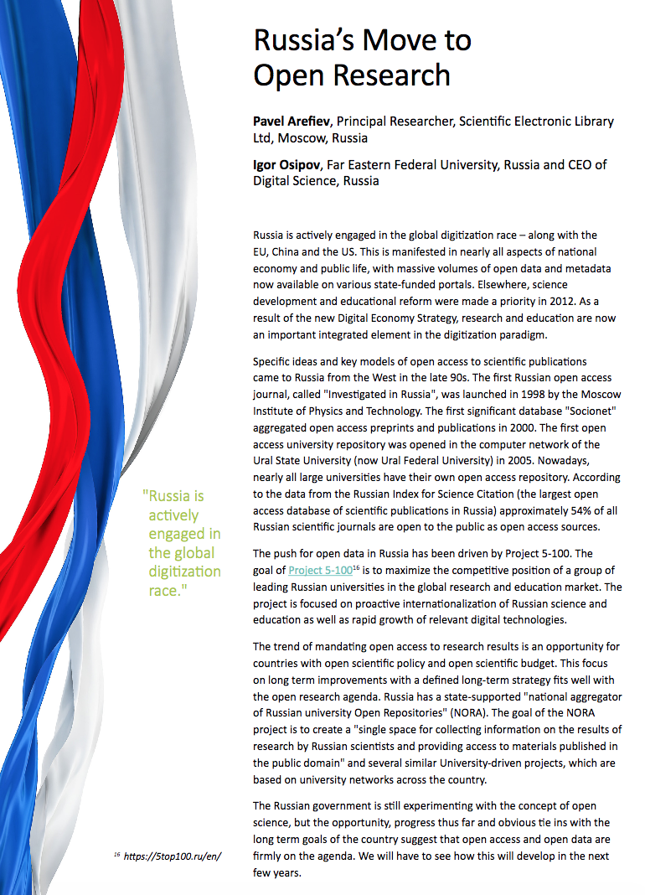
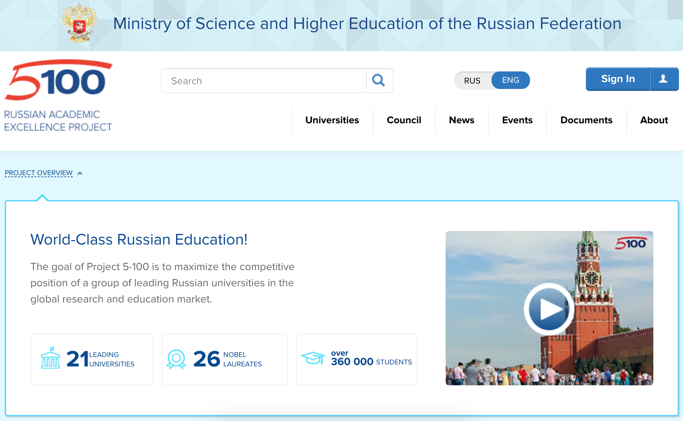
Notes:
Figshare open data survey

Slide 6
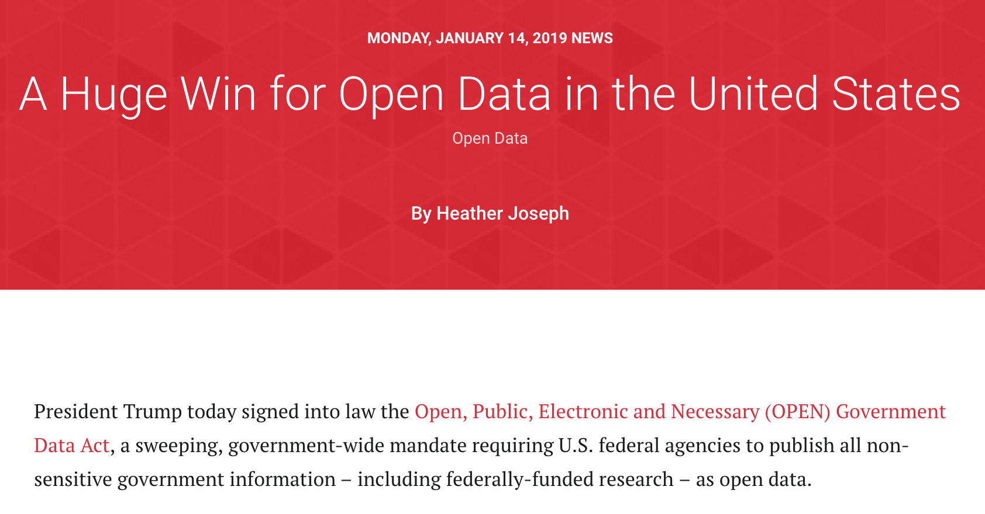
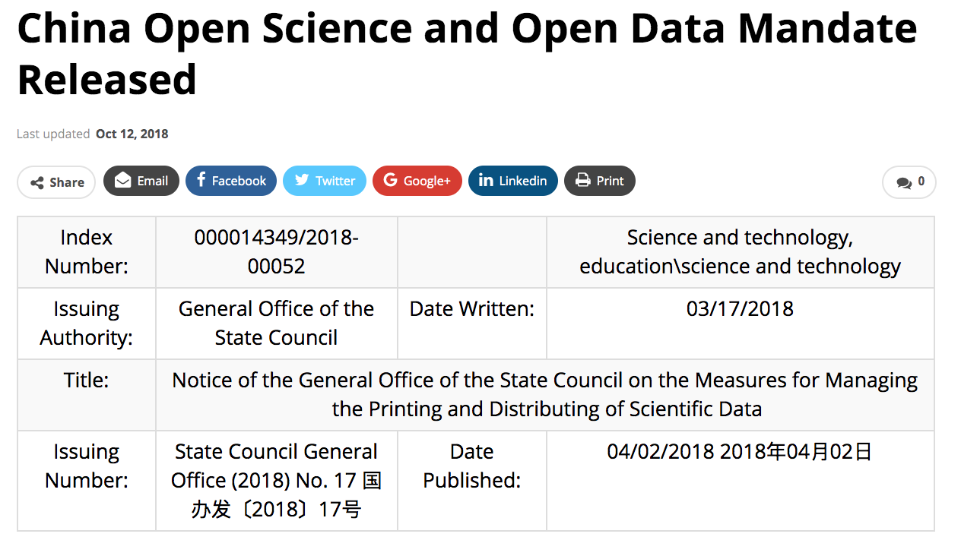

Slide 7
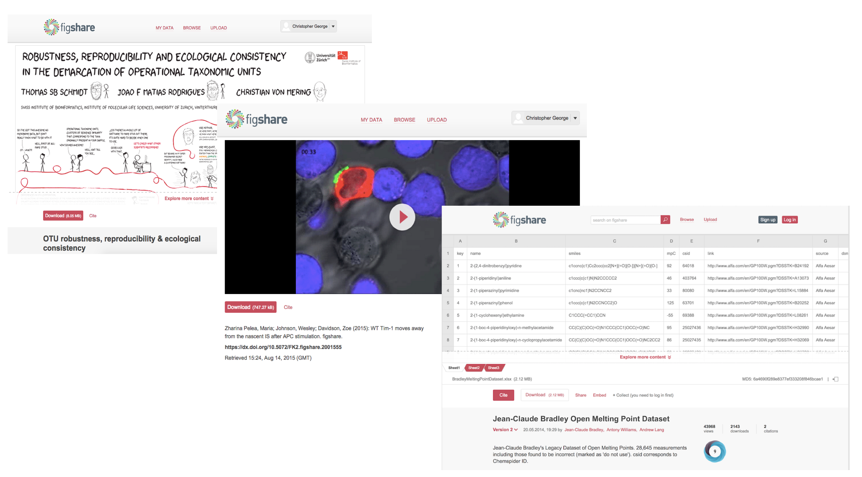

Slide 8
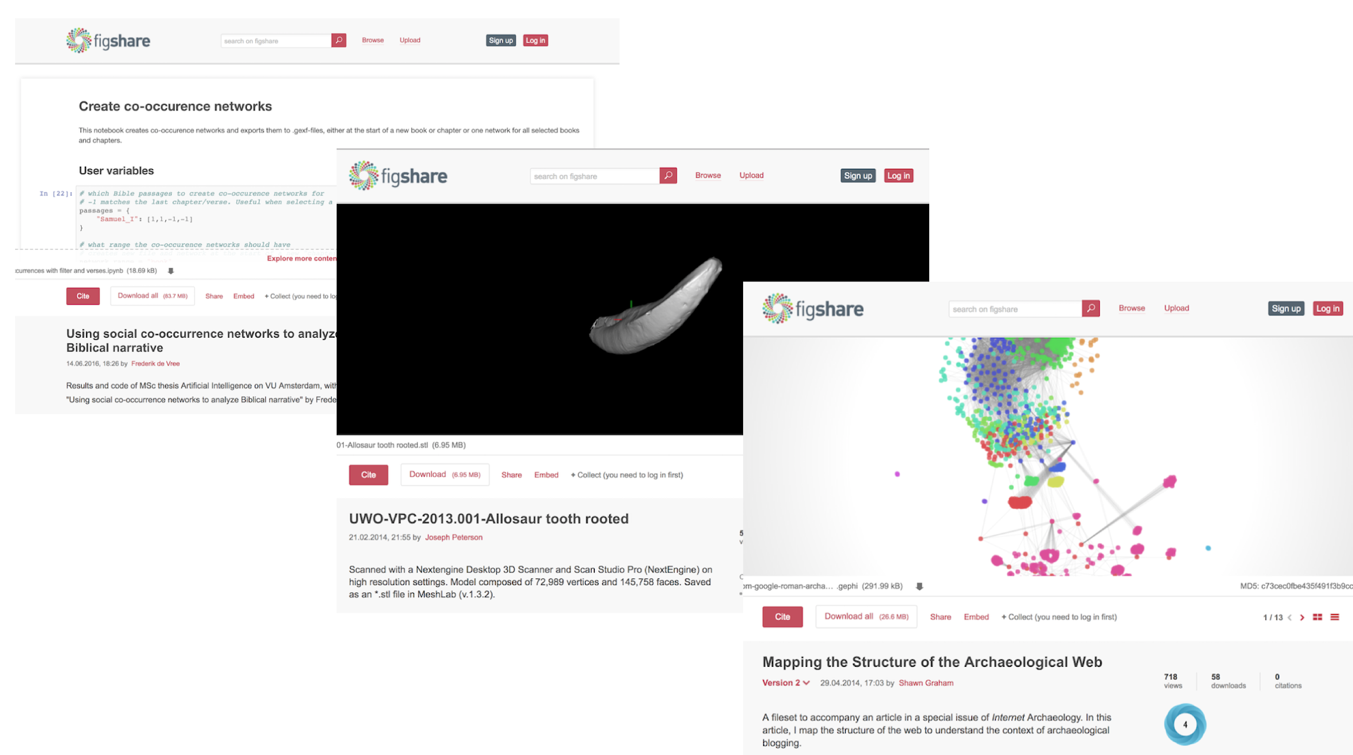

Slide 9
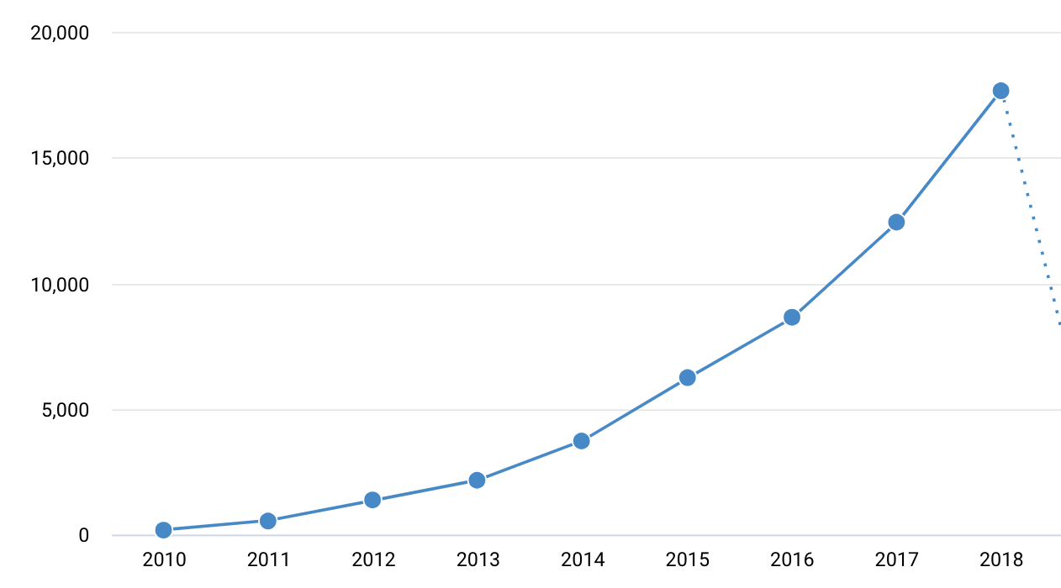
Notes:
test

Slide 10
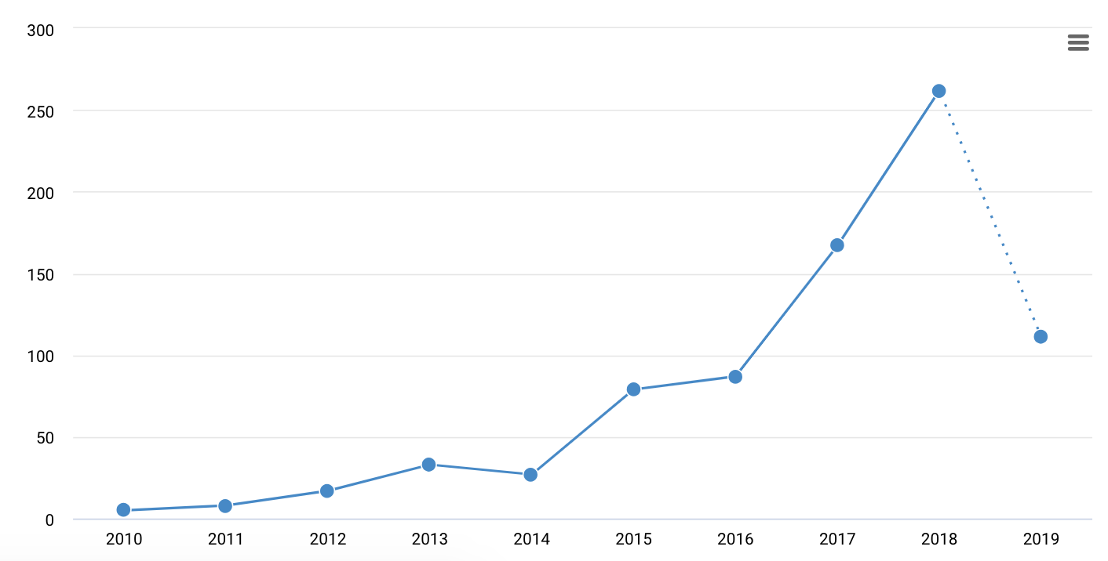
Papers from Russian Universities linking to datasets on Figshare

Slide 11
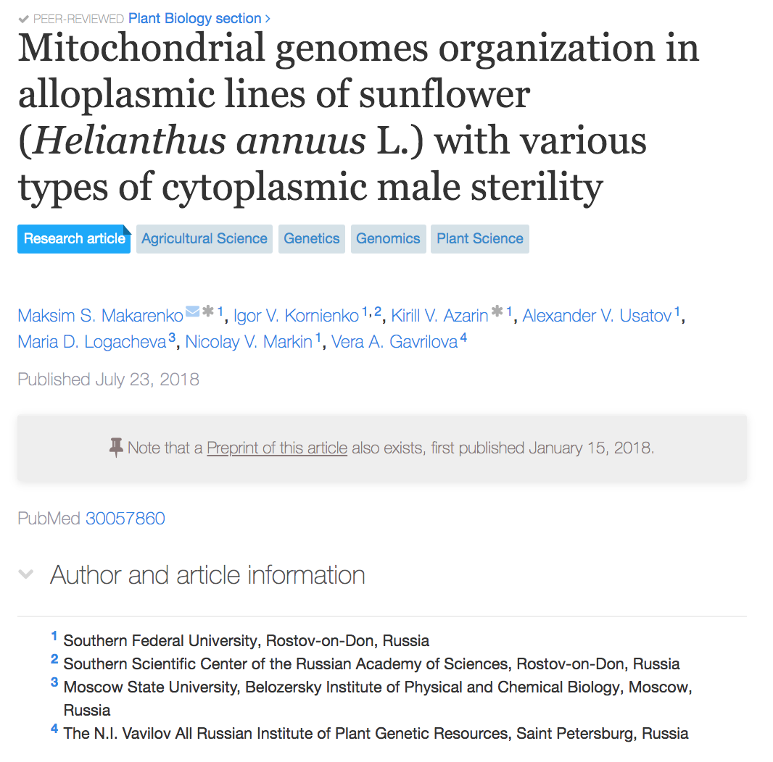
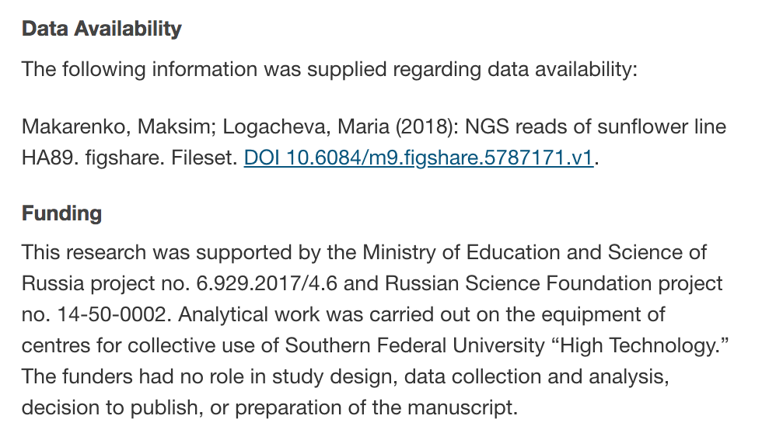
Papers from Russian Universities linking to datasets on Figshare

Slide 12
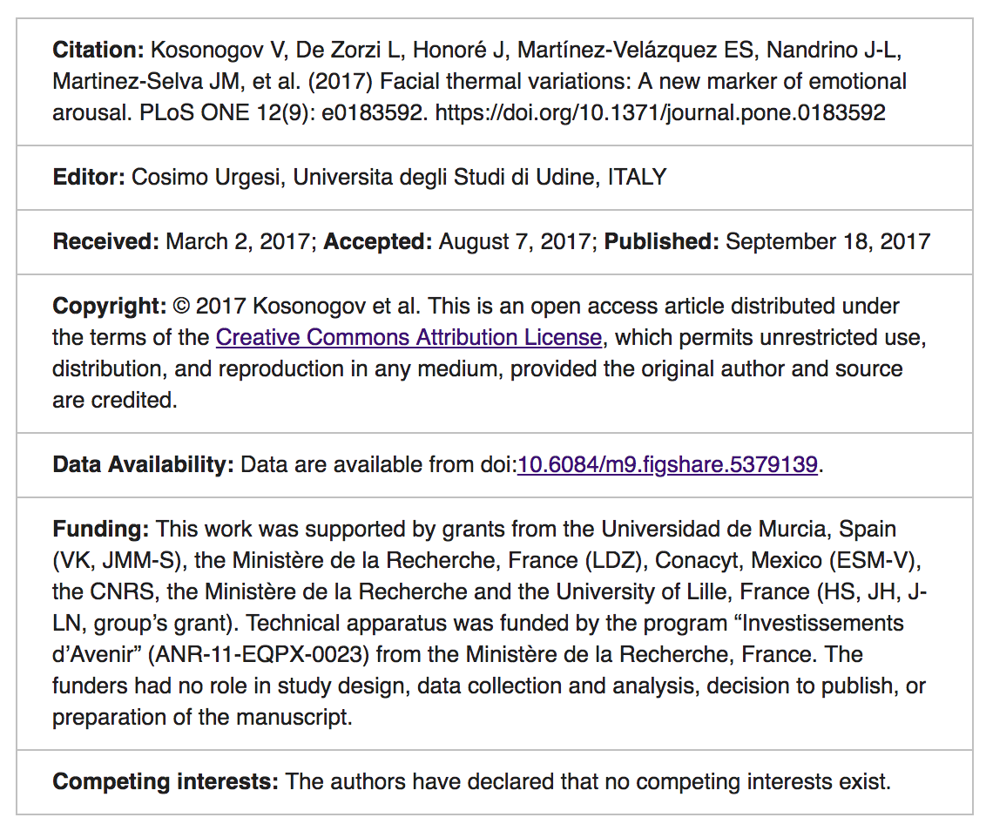
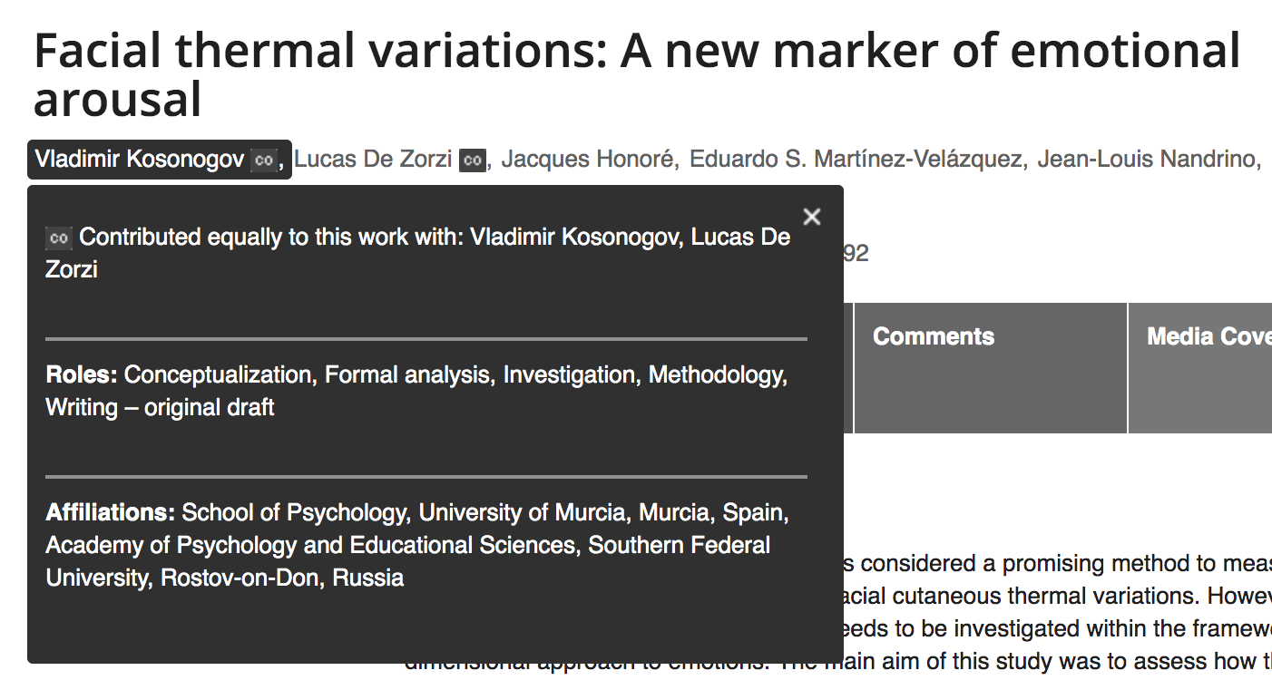
Papers from Russian Universities linking to datasets on Figshare

Slide 13
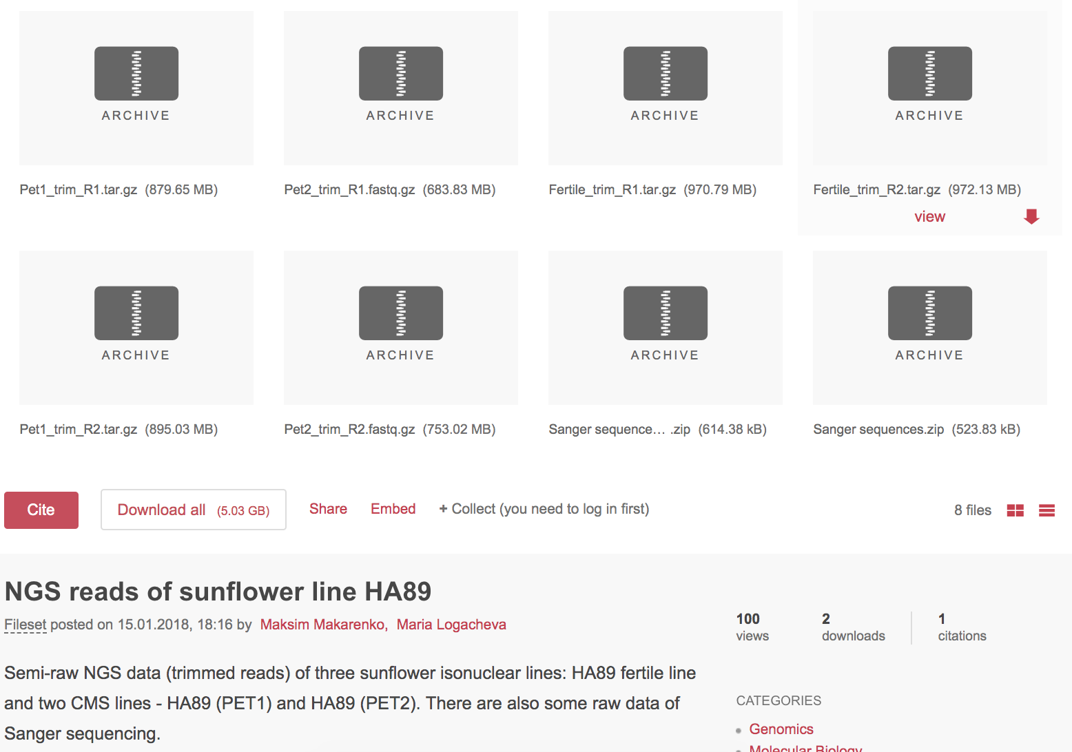
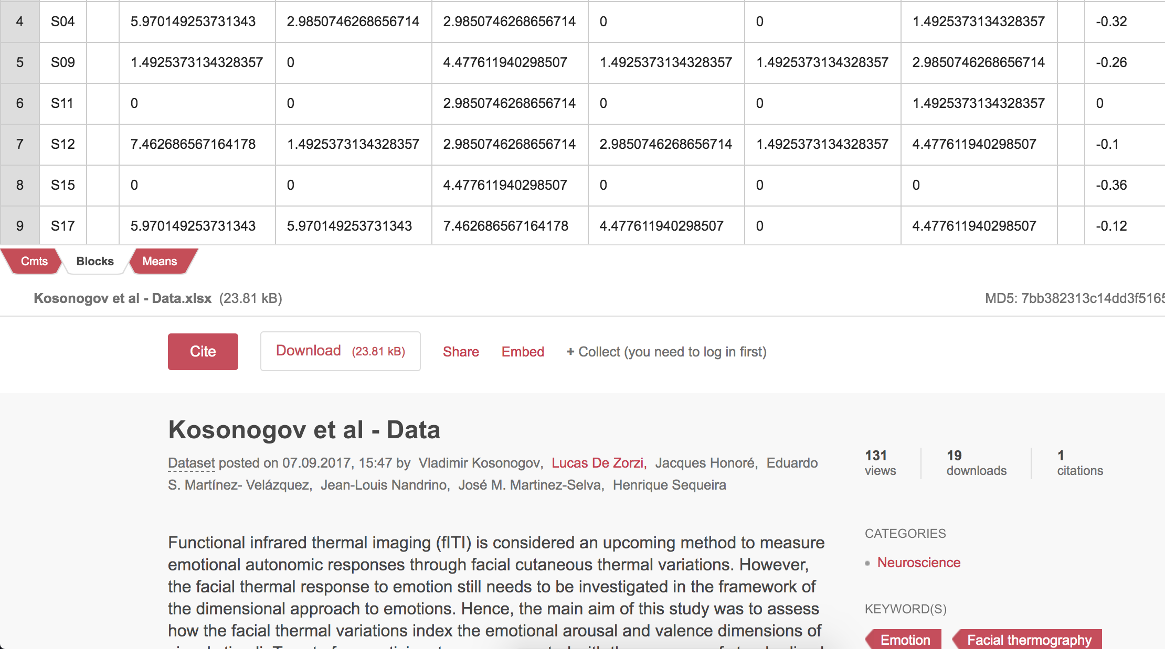
Papers from Russian Universities linking to datasets on Figshare

Slide 14
Why are researchers doing this?

Slide 15
Papers from Russian Universities linking to datasets on Figshare

Slide 16
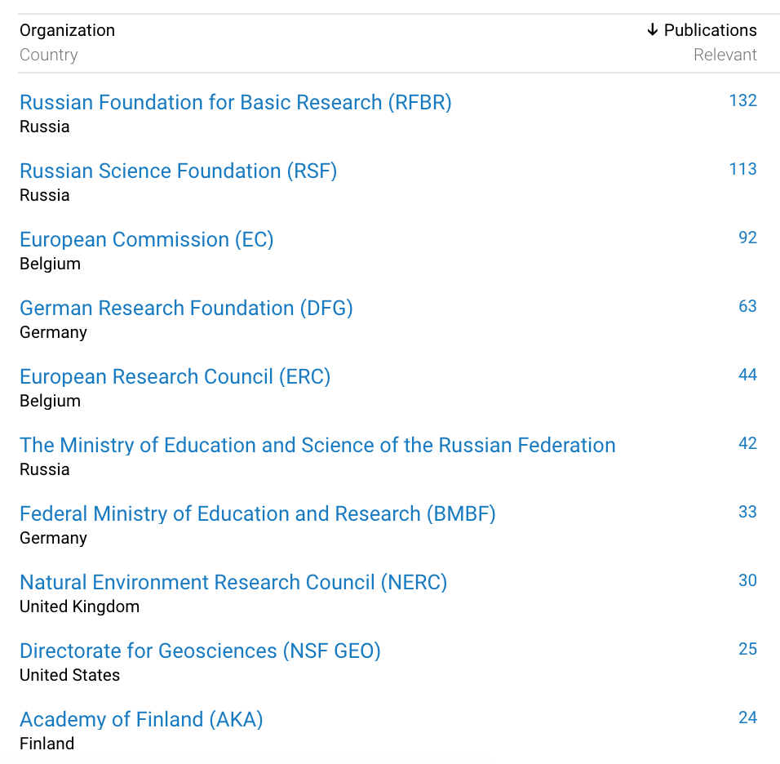

Slide 17
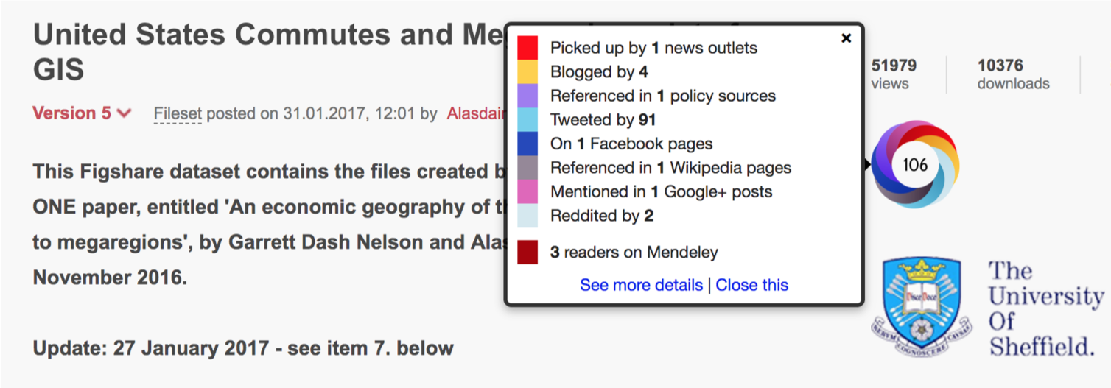

Slide 18
Types of Content

Slide 19
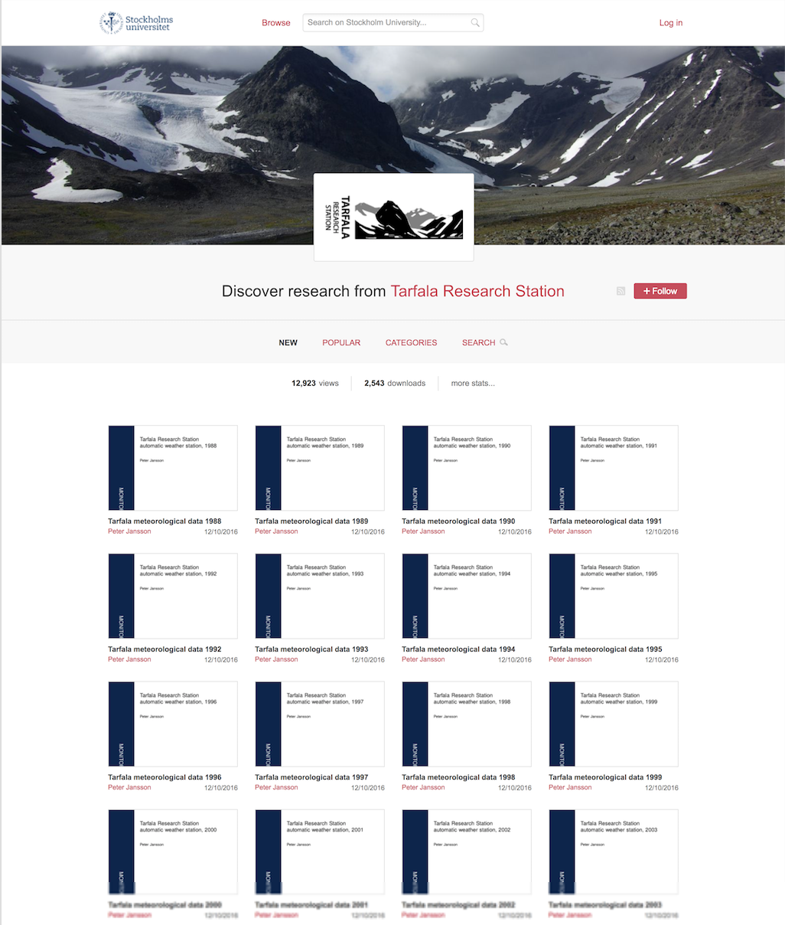

Slide 20
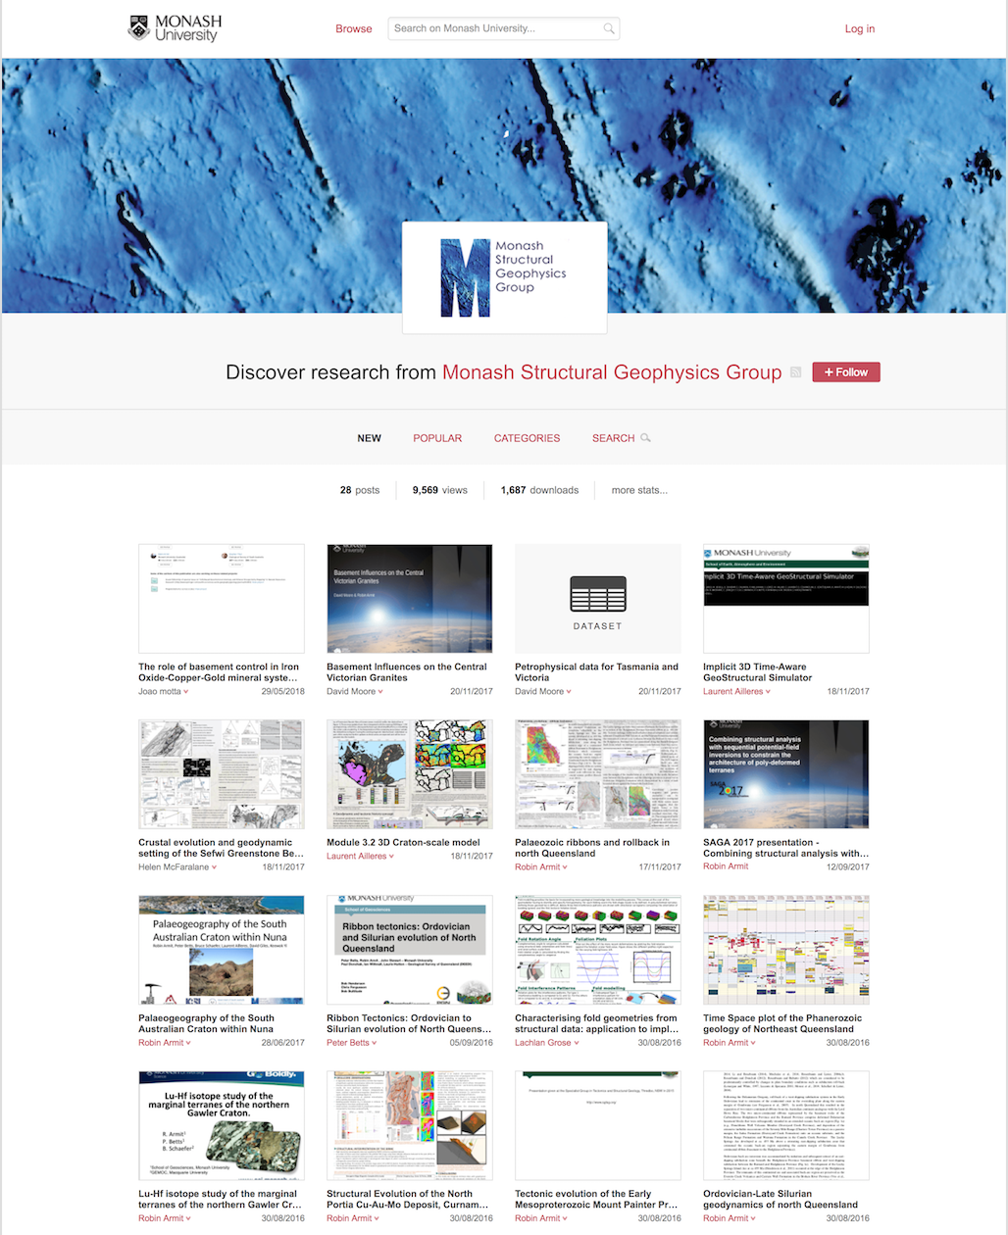
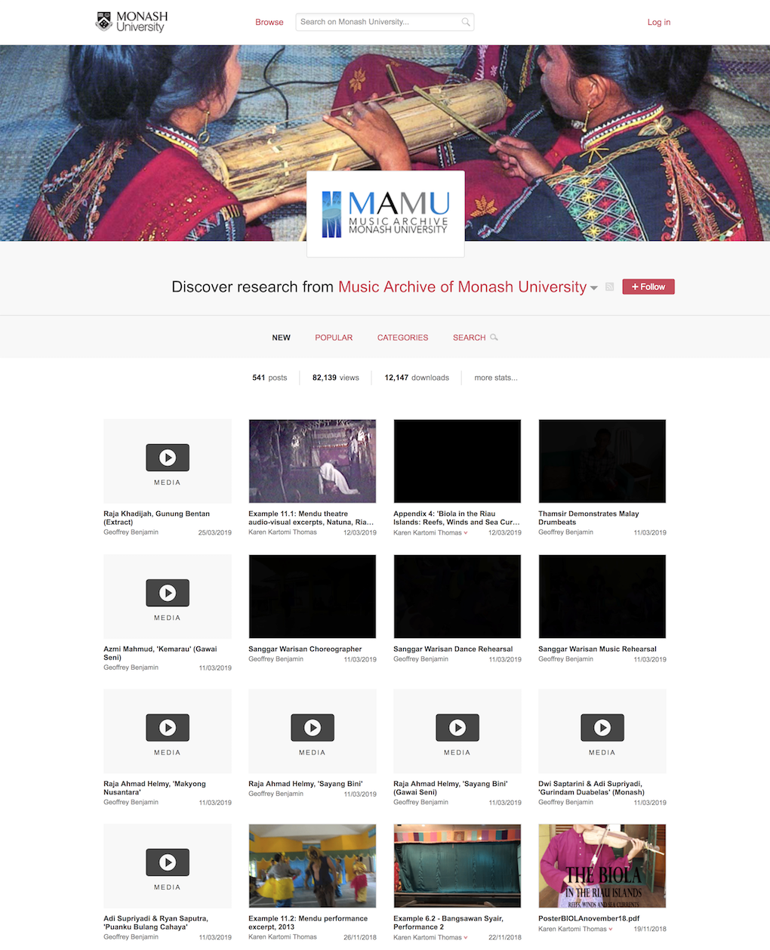

Slide 21
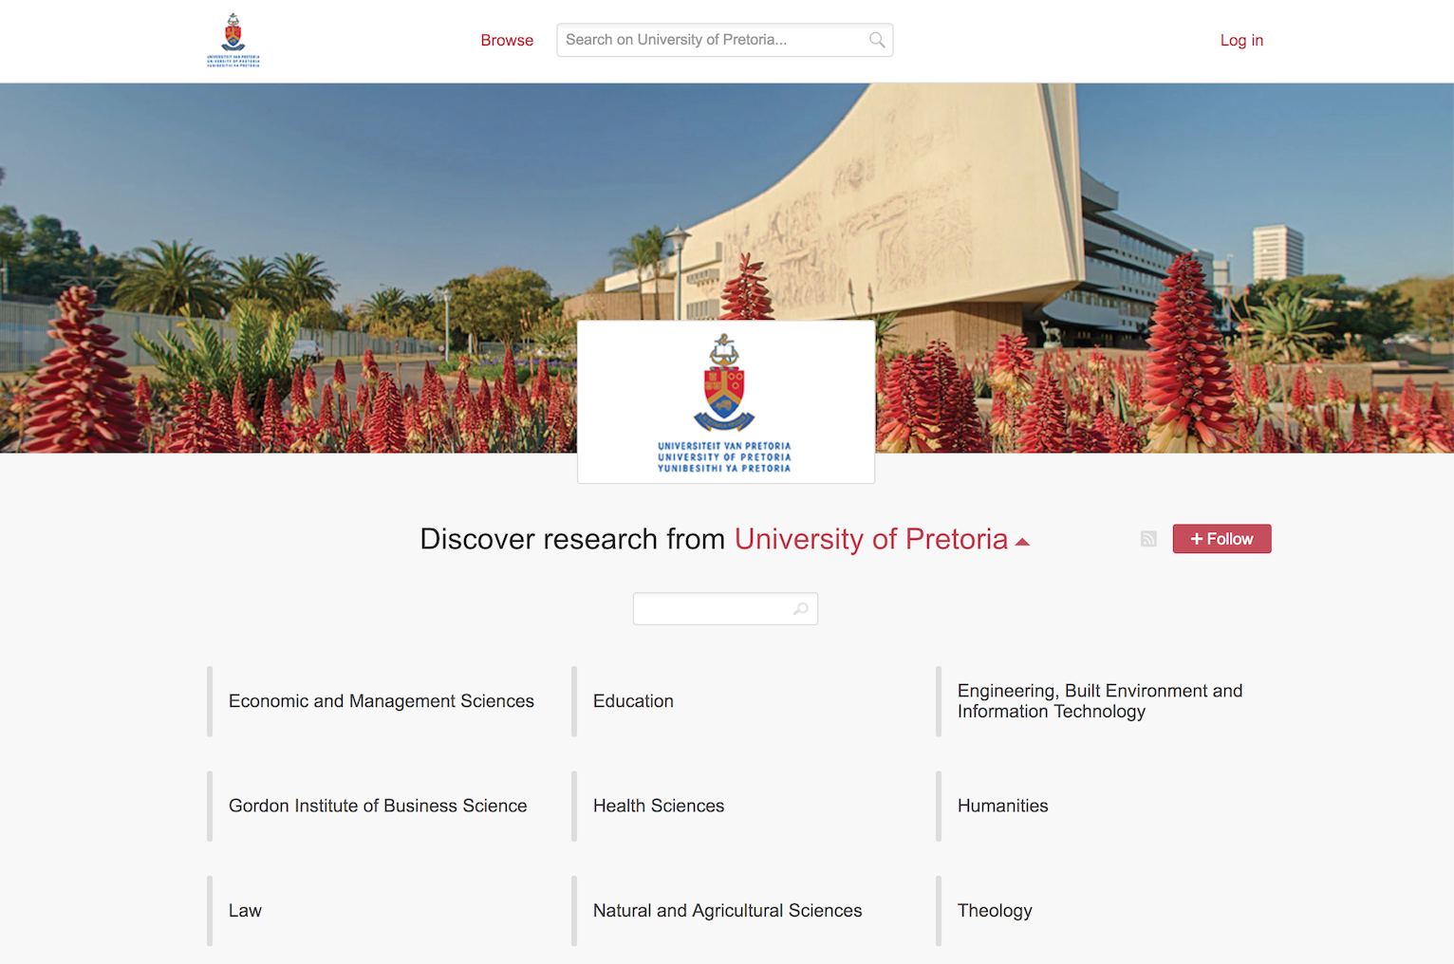

Slide 22
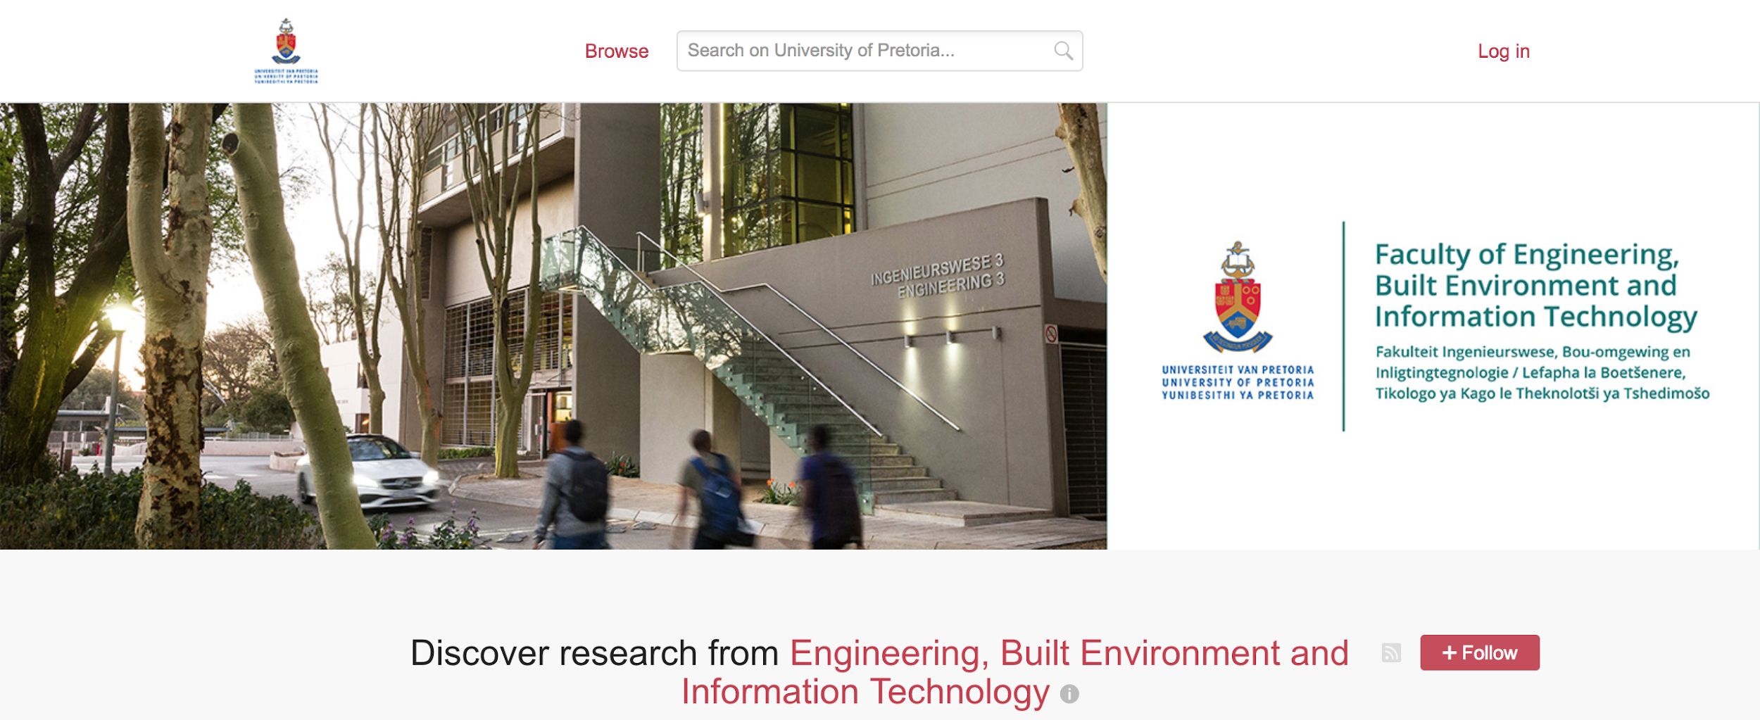
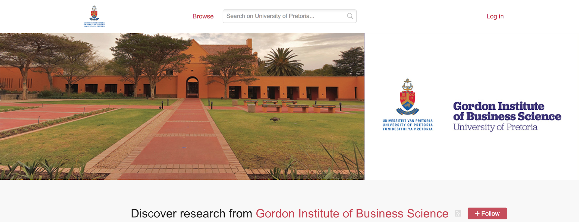
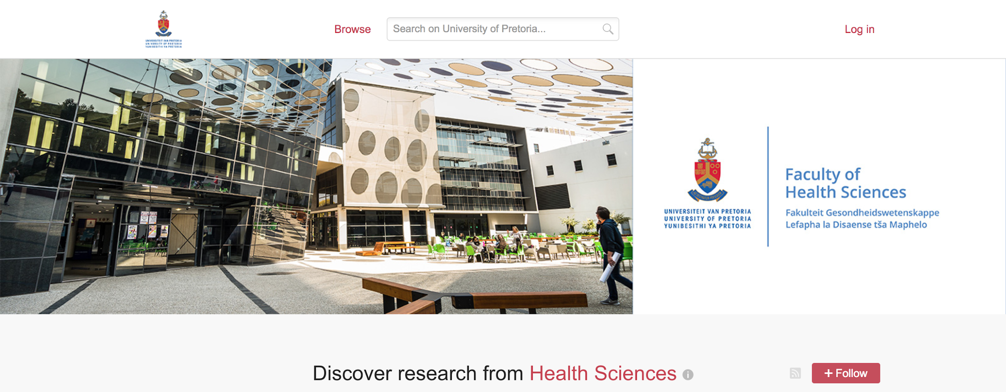
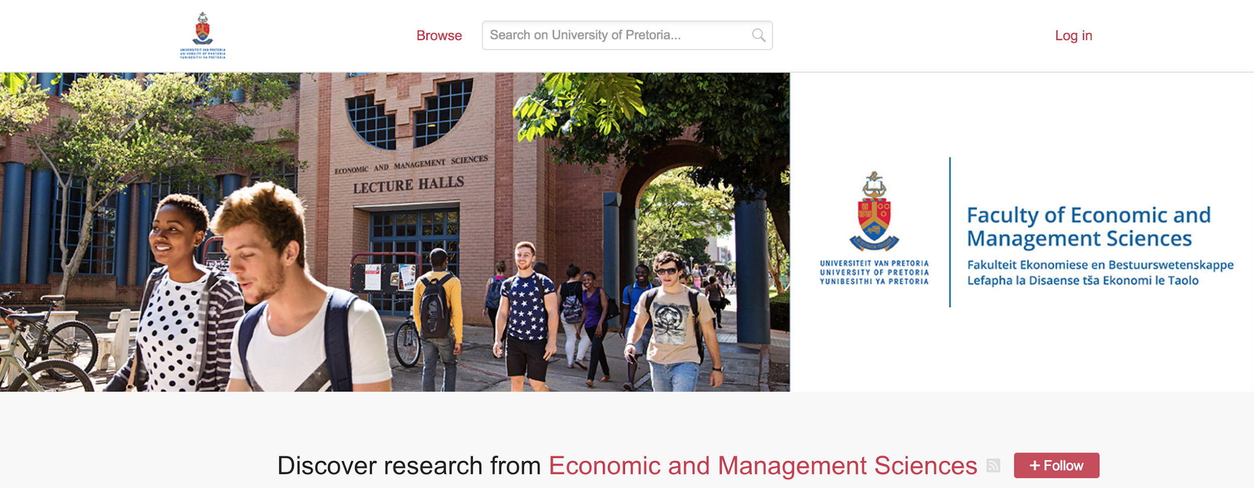

Slide 23
“This DSpace instance has become more than a little long in the tooth and the University recently went out to tender to replace that system. The winner of that exercise was Figshare and so we are now gradually working towards both publications and research data appearing in the one repository.”
http://www.ariadne.ac.uk/issue/78/towns/
Mapping custom fields to DC export OAI for theses harvesting
Handle minting
New admin area
Custom item types
Publication date/dates clarification
Cover sheet for PDFs

Slide 25
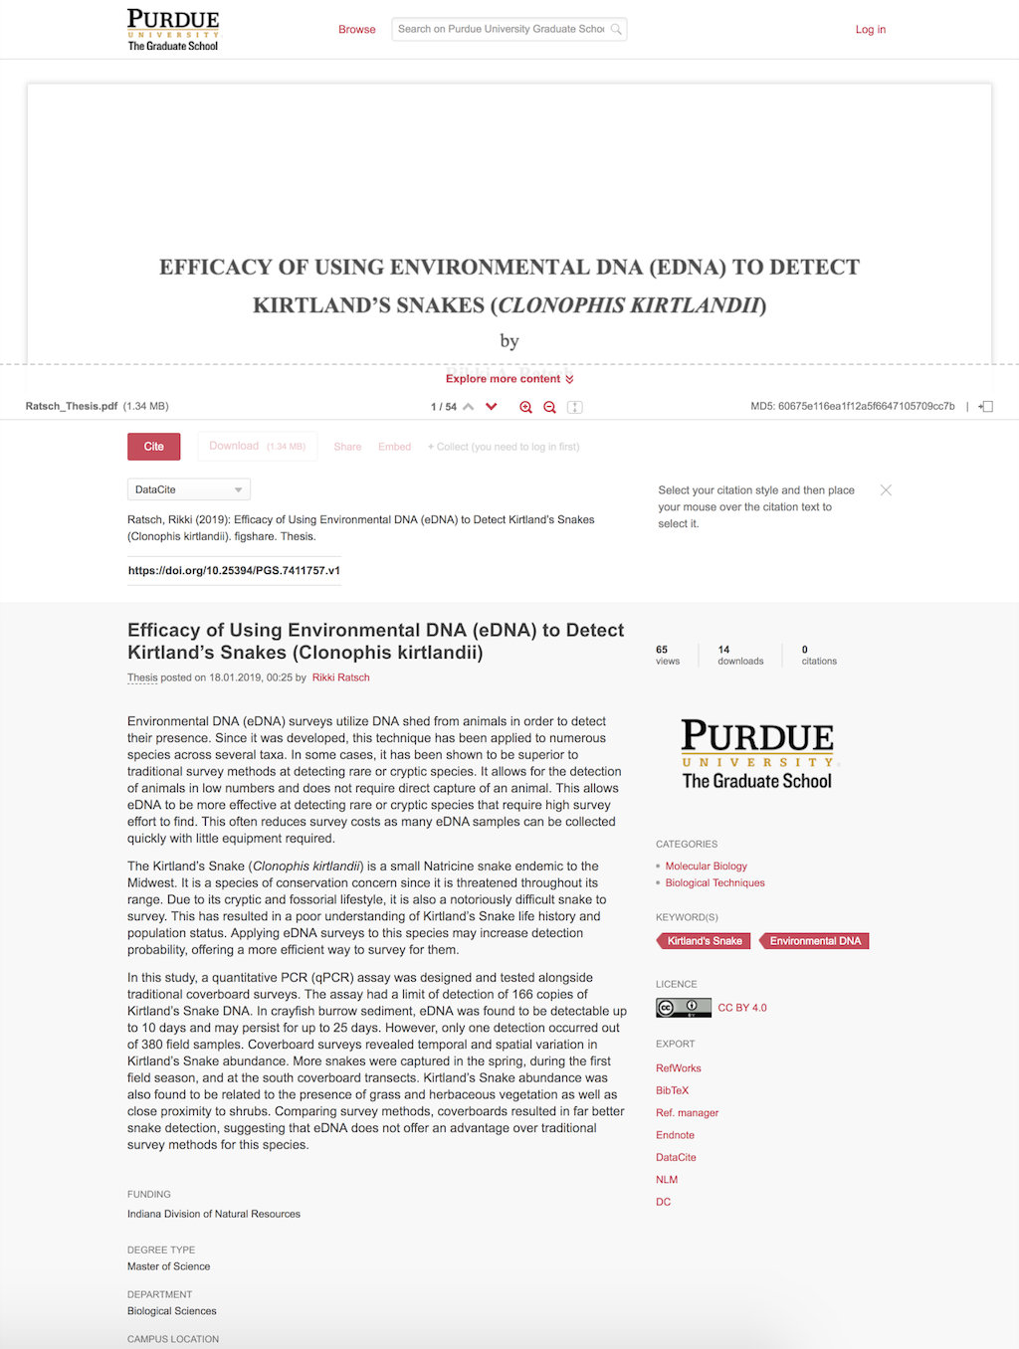
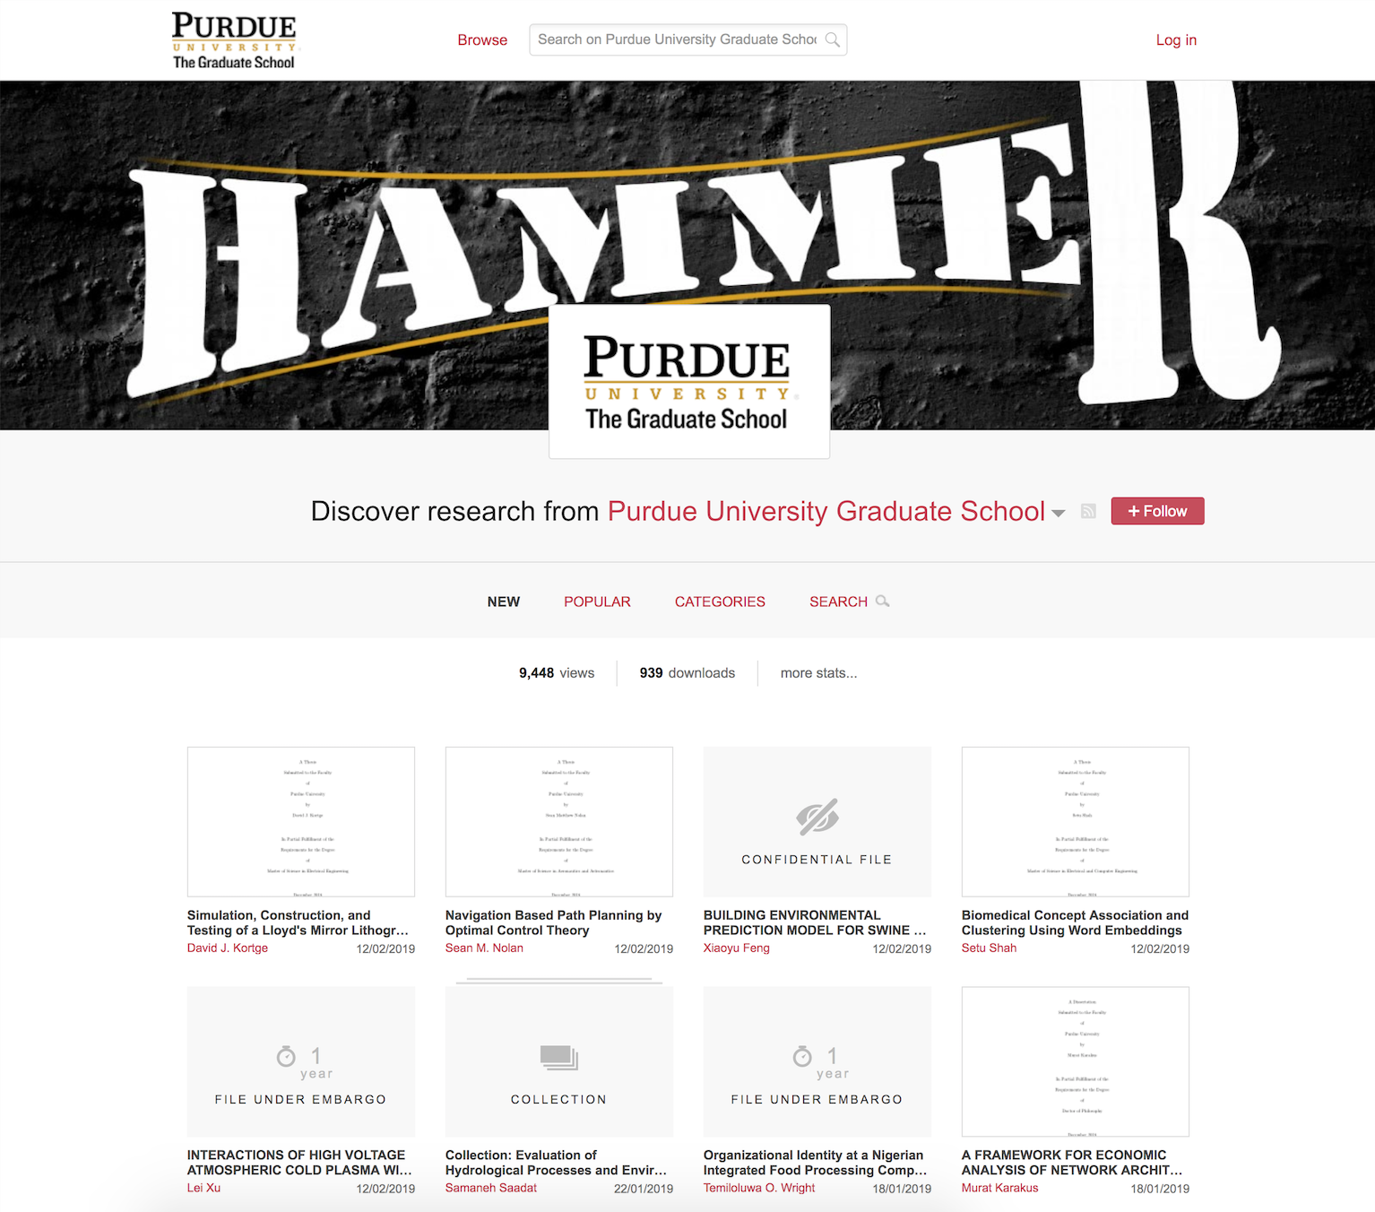

Slide 26
Museums

Slide 27
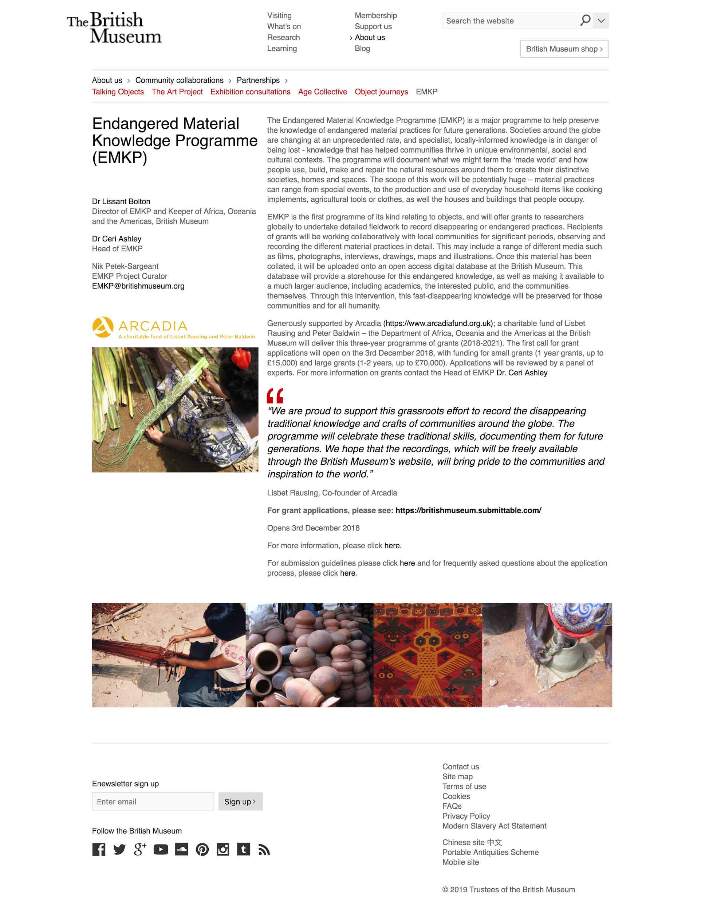

Slide 28
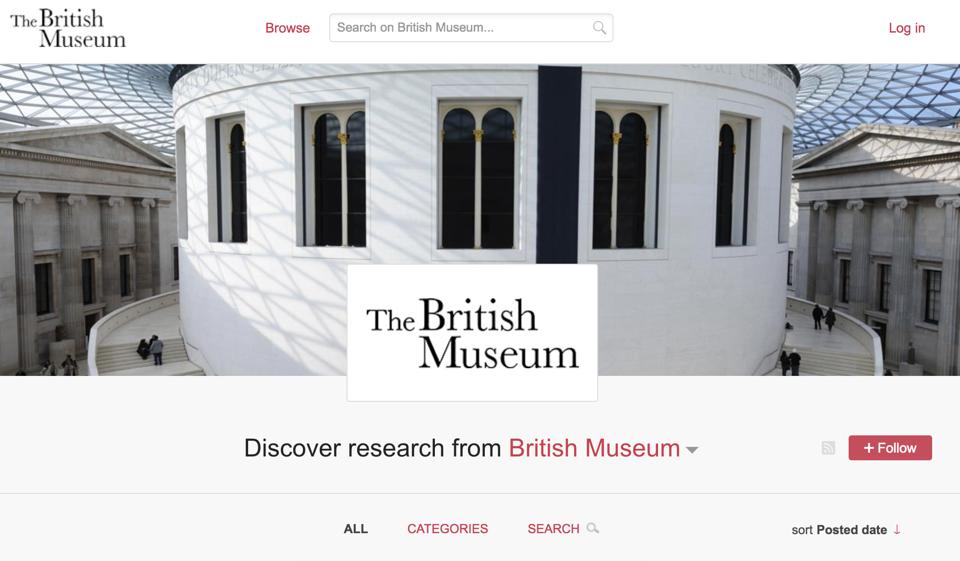

Slide 29
Infrastructure

Slide 30
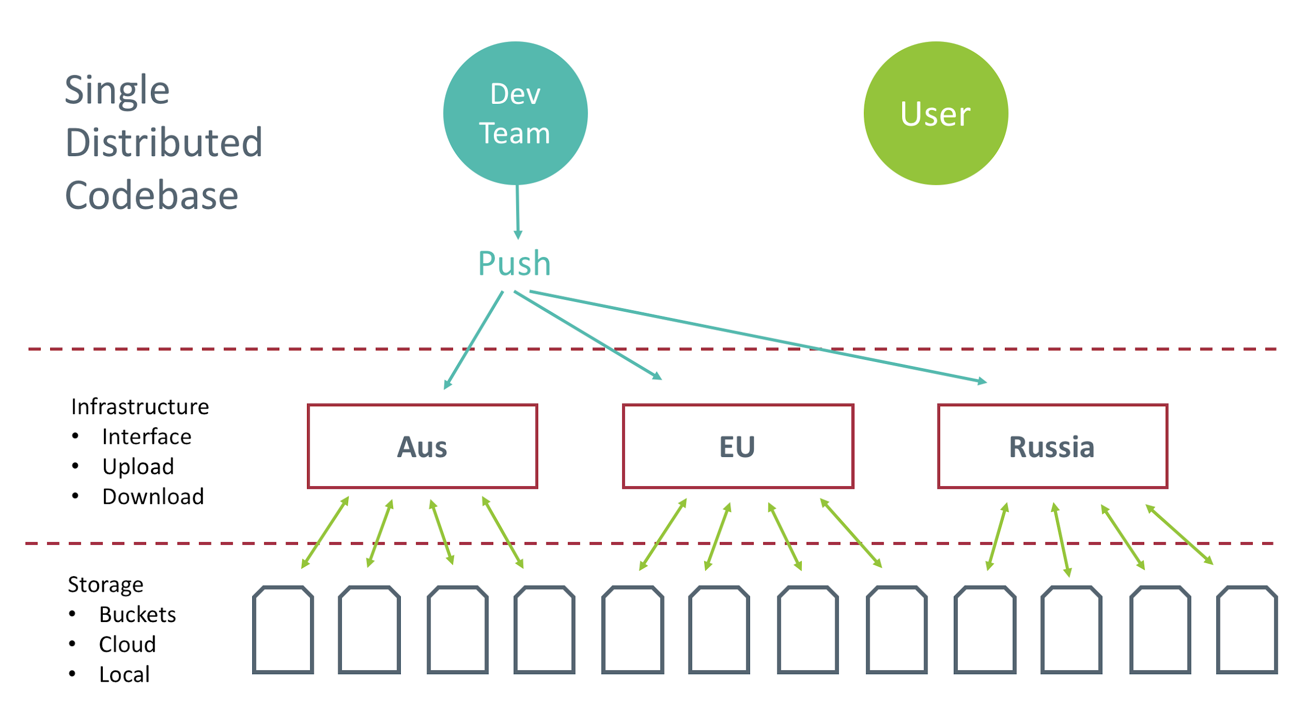

Slide 31
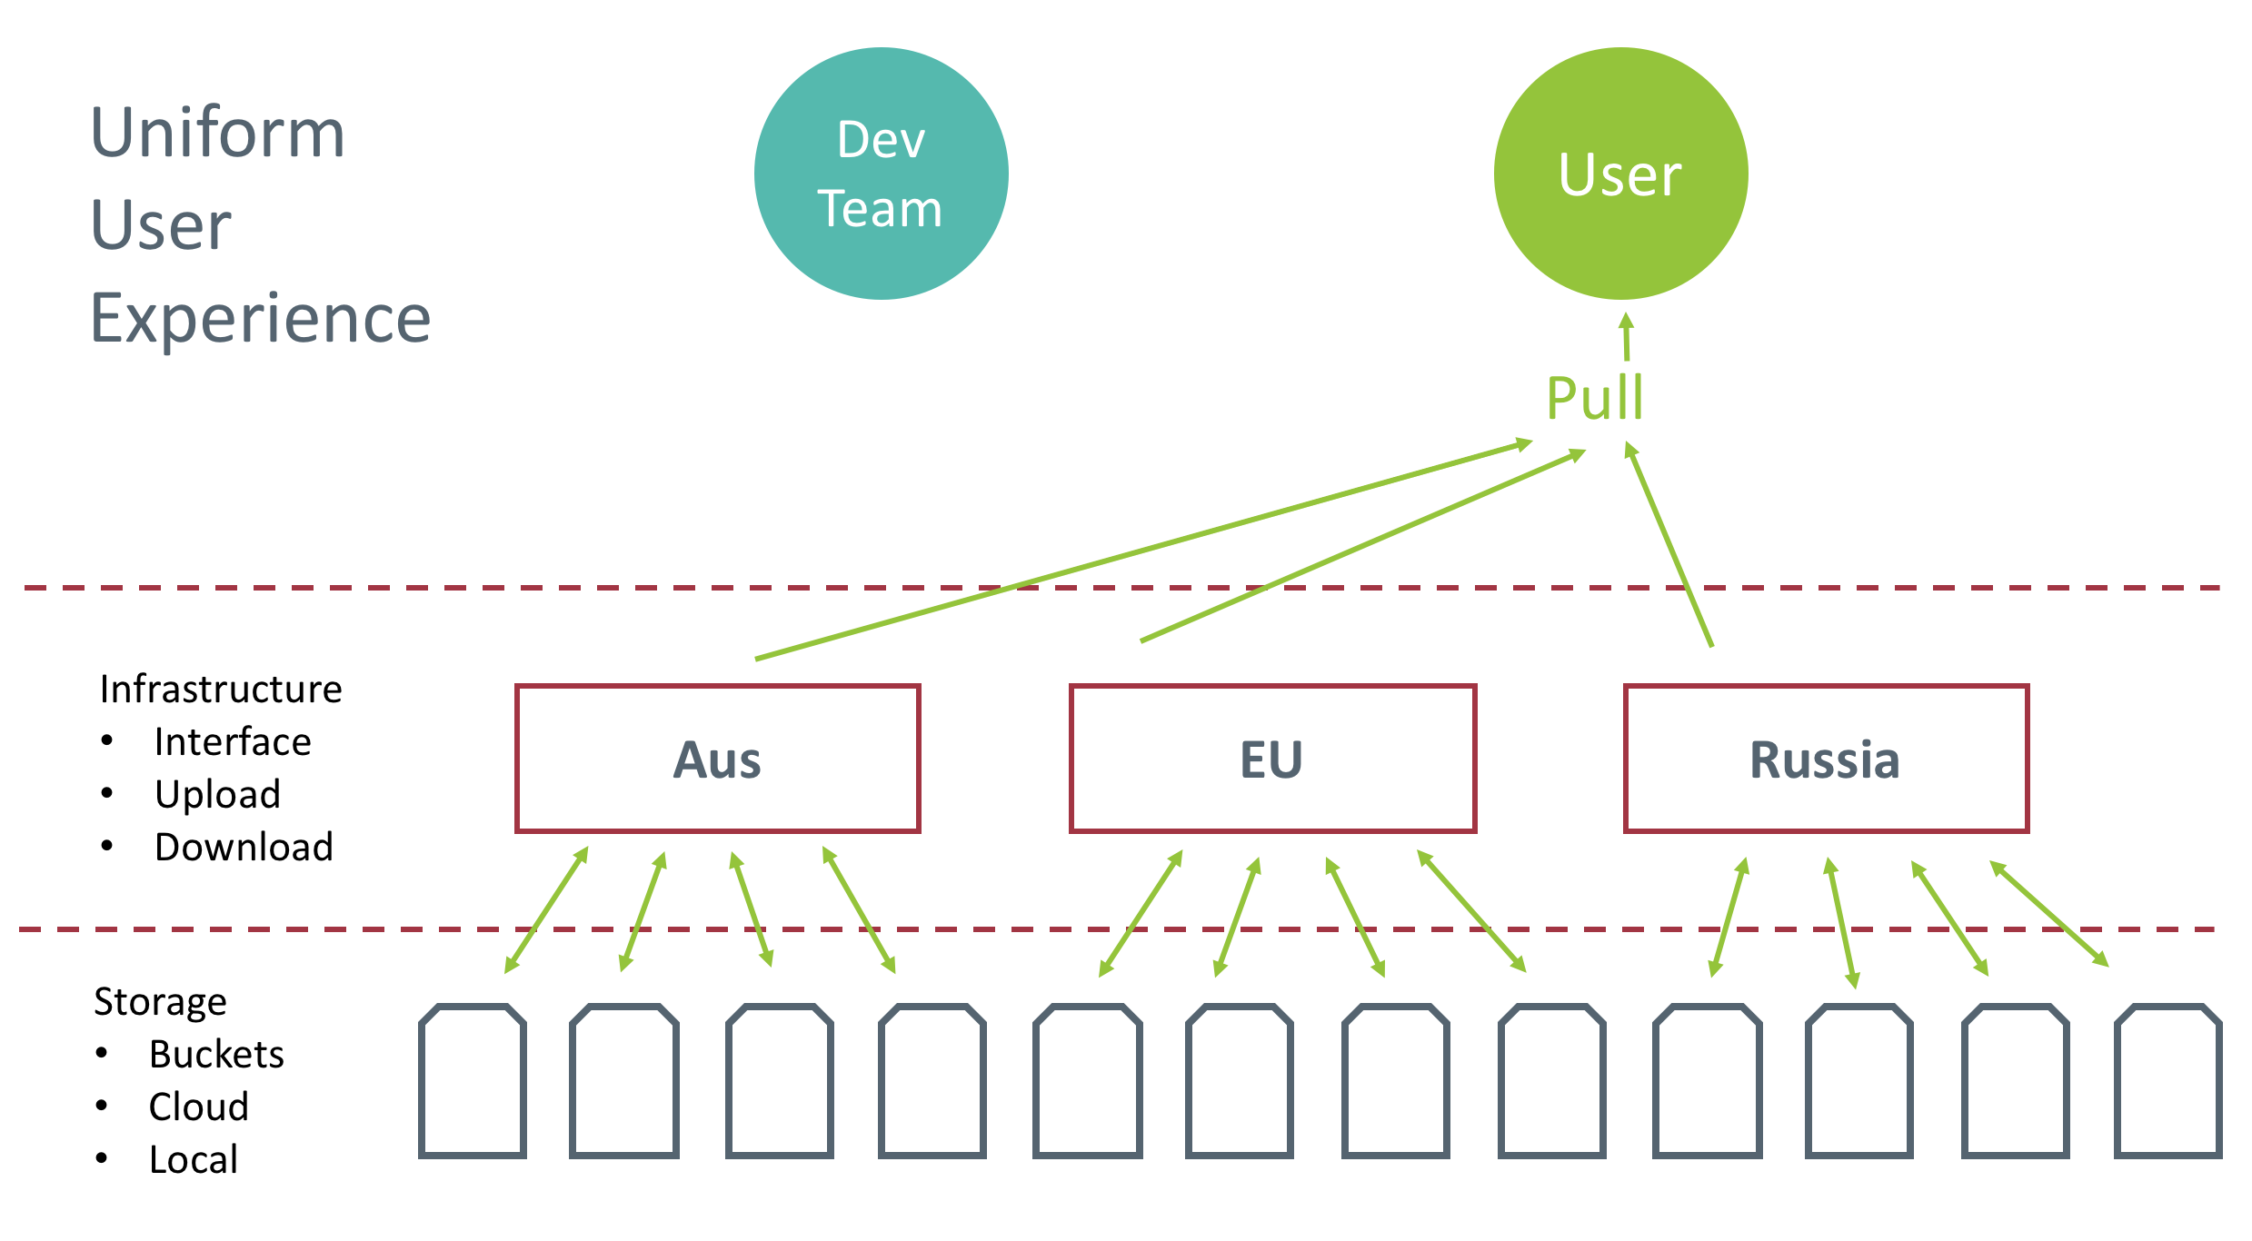

Slide 32
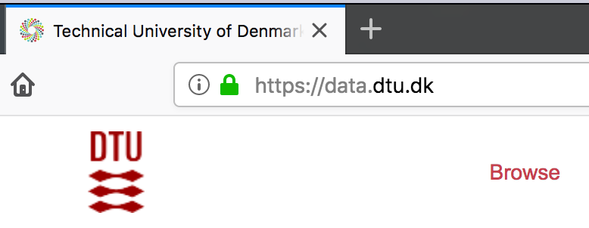
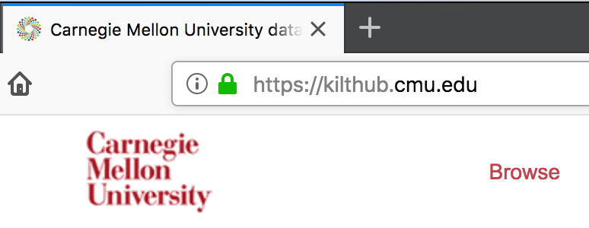
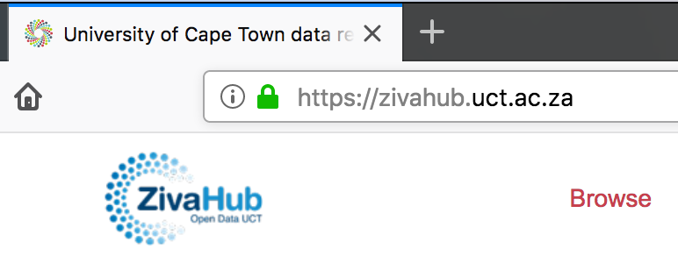

Slide 33
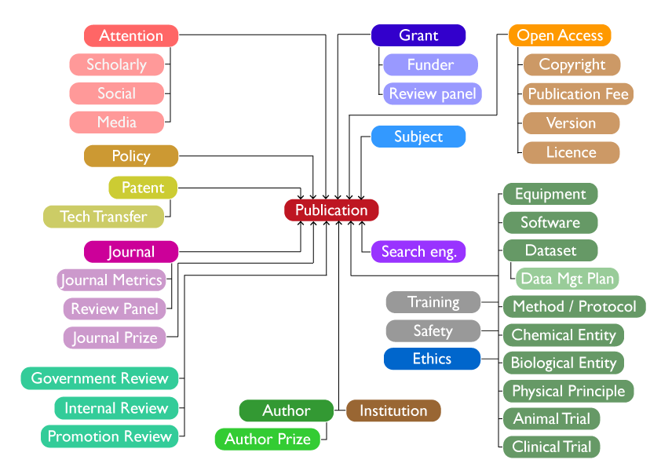

Slide 34
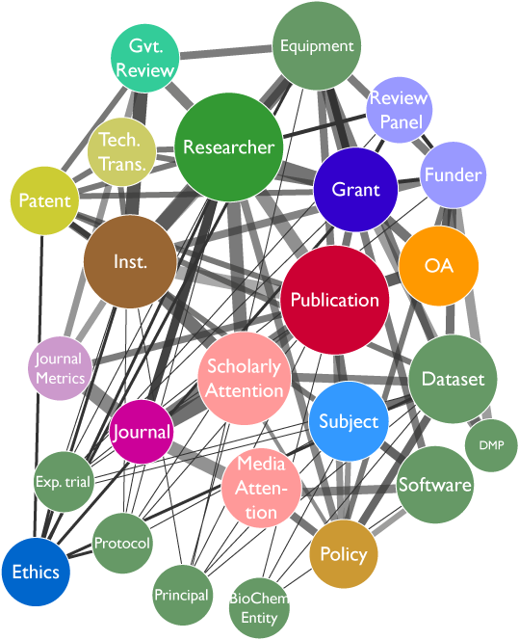

Slide 35
APIs

Slide 36
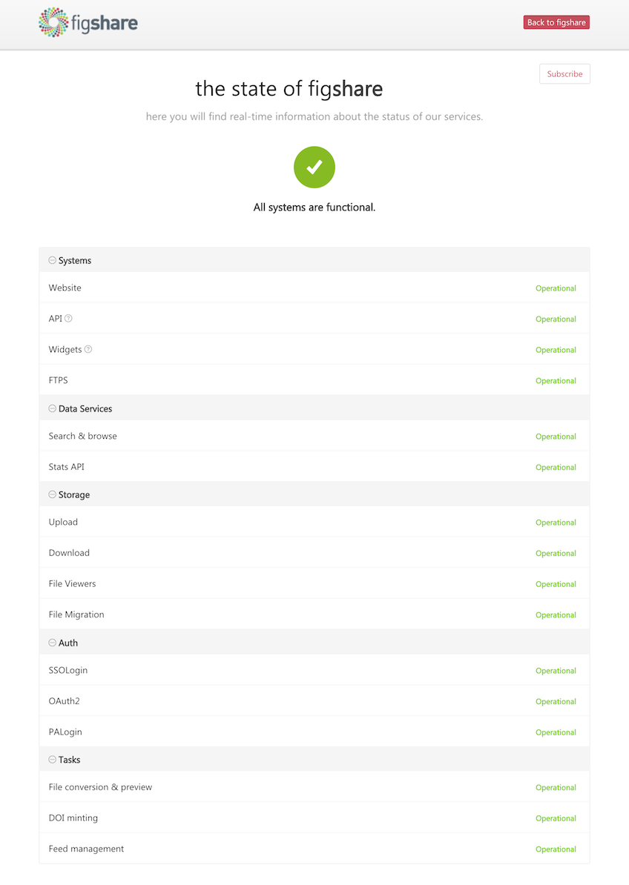
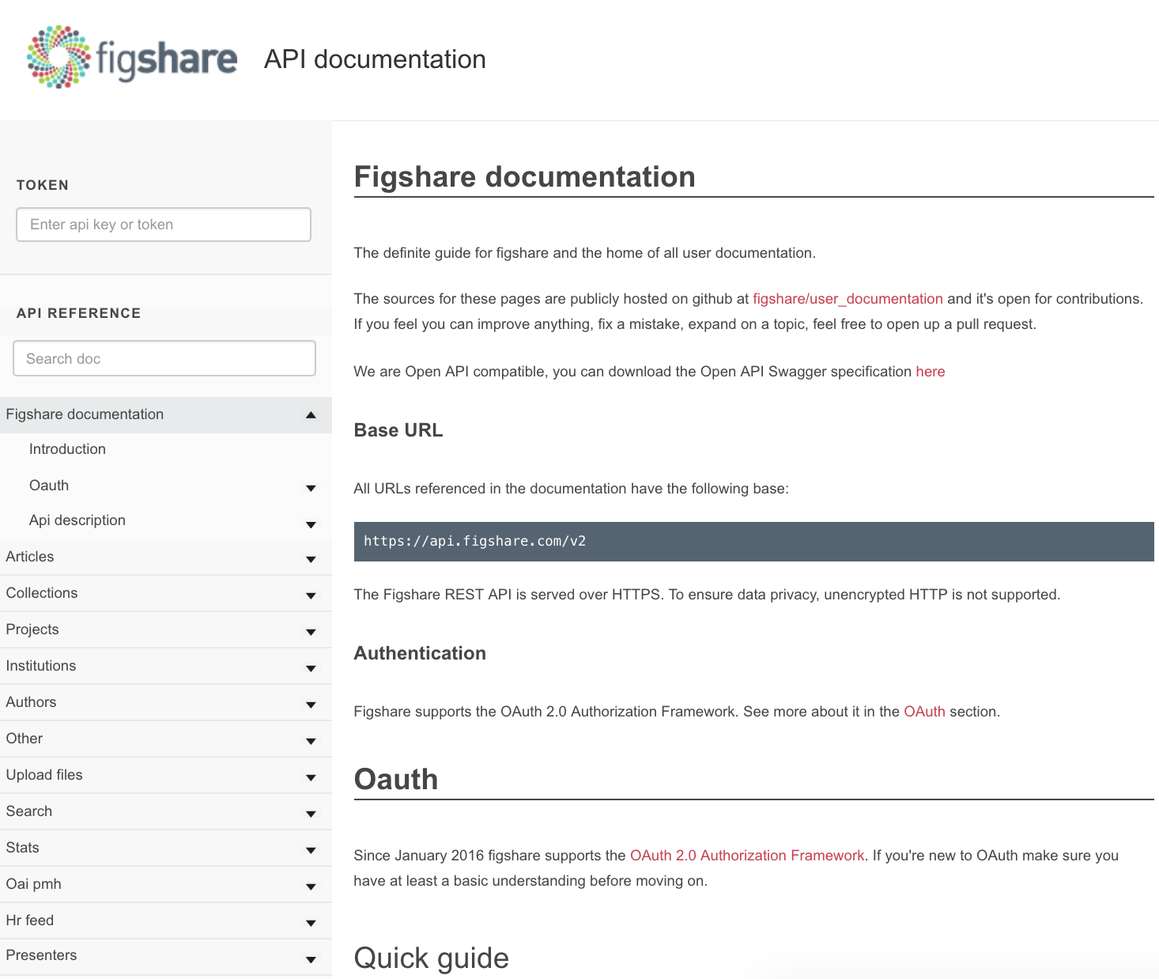

Slide 37
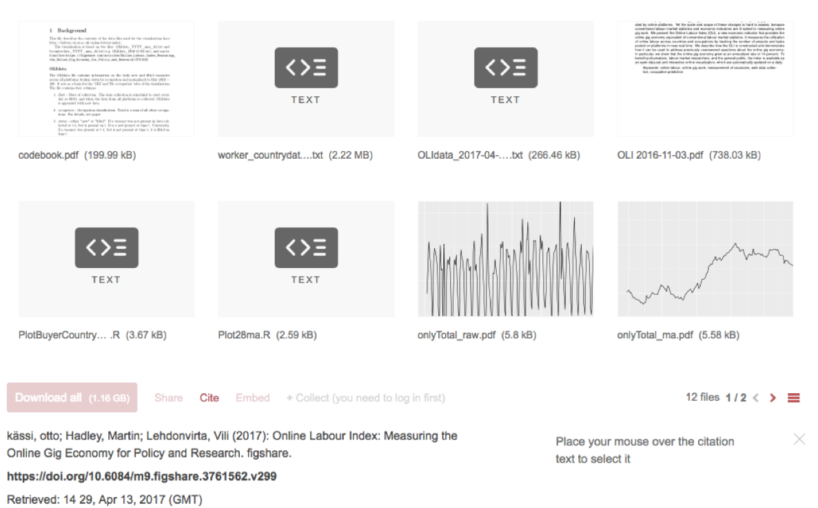
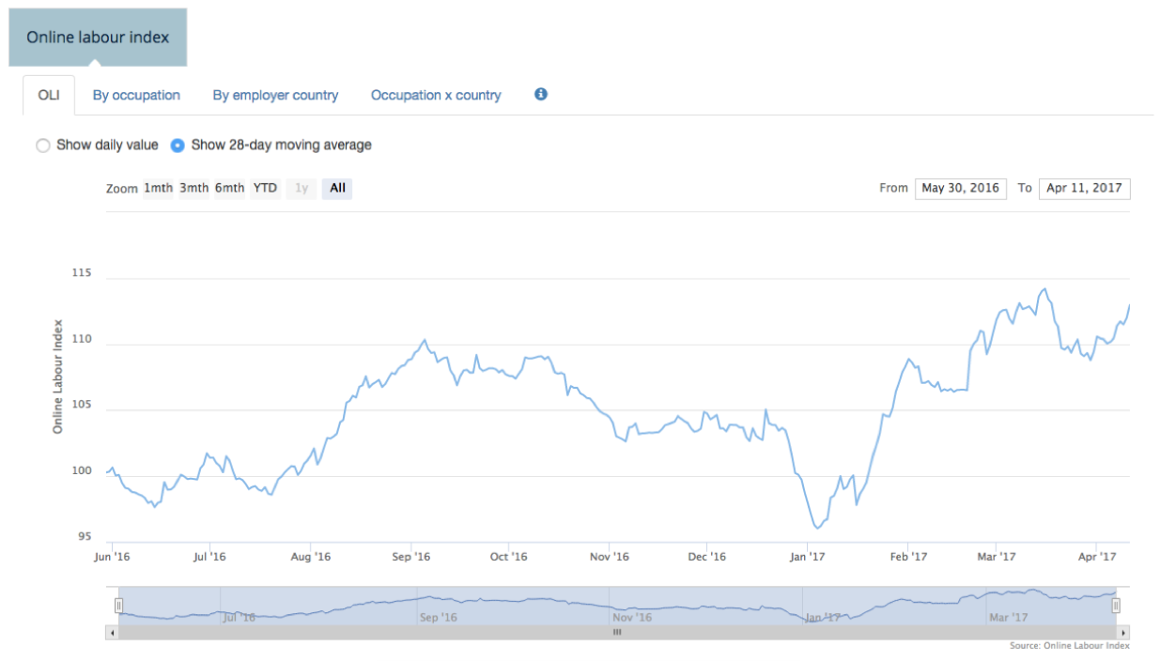

Slide 38
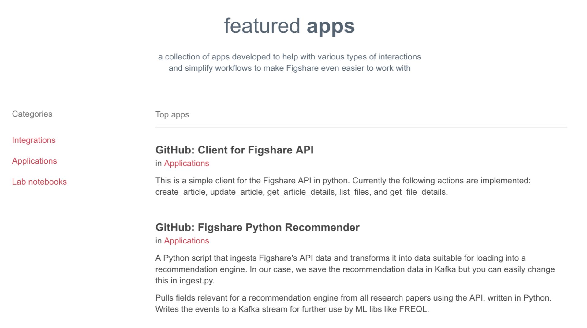

Slide 39
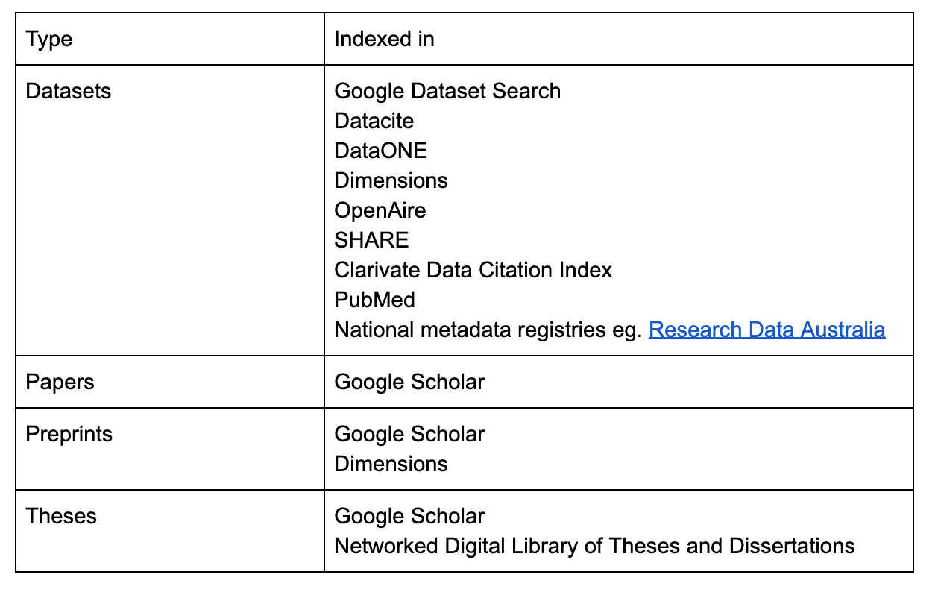
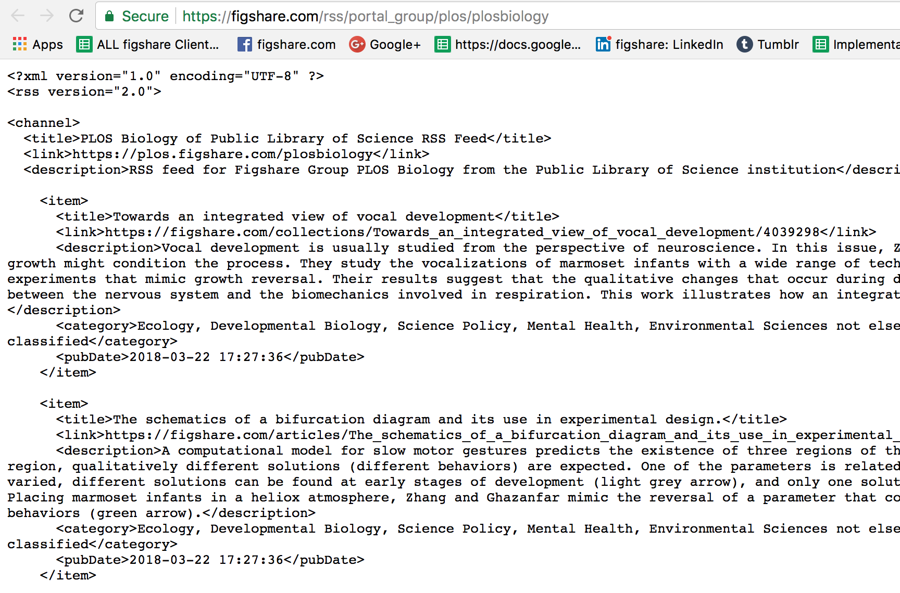
Support for open standards and de facto standards

Slide 40
Aggregation

Slide 41
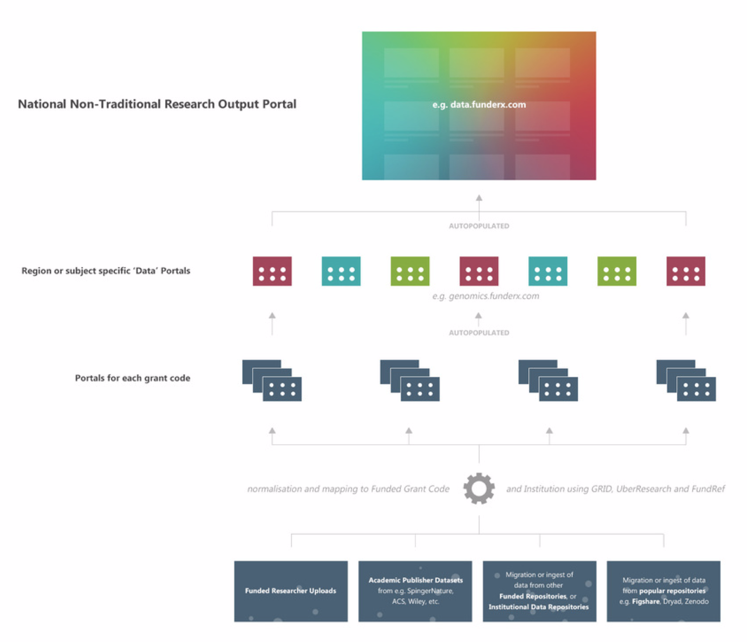

Slide 43
Mark Hahnel
Function: CEO
Email: mark@figshare.com

Slide 44
Restrict files / files and metadata to one or multiple groups of users from your institution
Restrict files / files and metadata to all logged in users
Restrict based on an IP range/ several IP ranges

Slide 45
New Search
Notes:
test

Slide 46
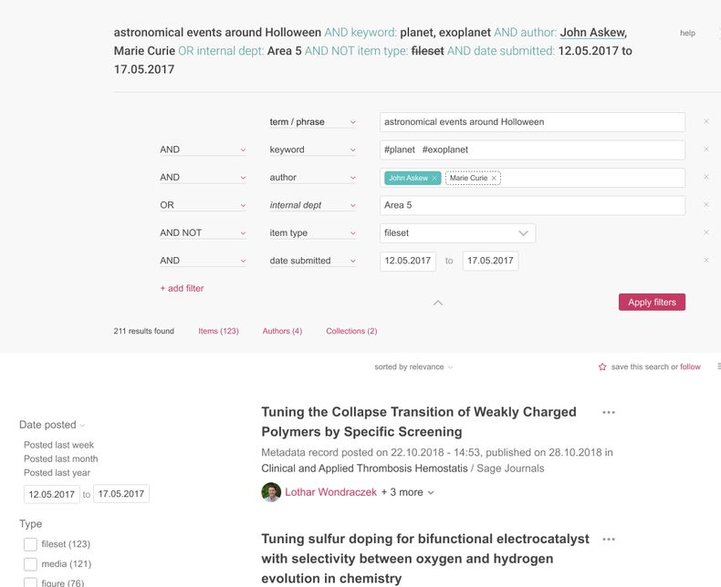
New Search
Notes:
test

Slide 47
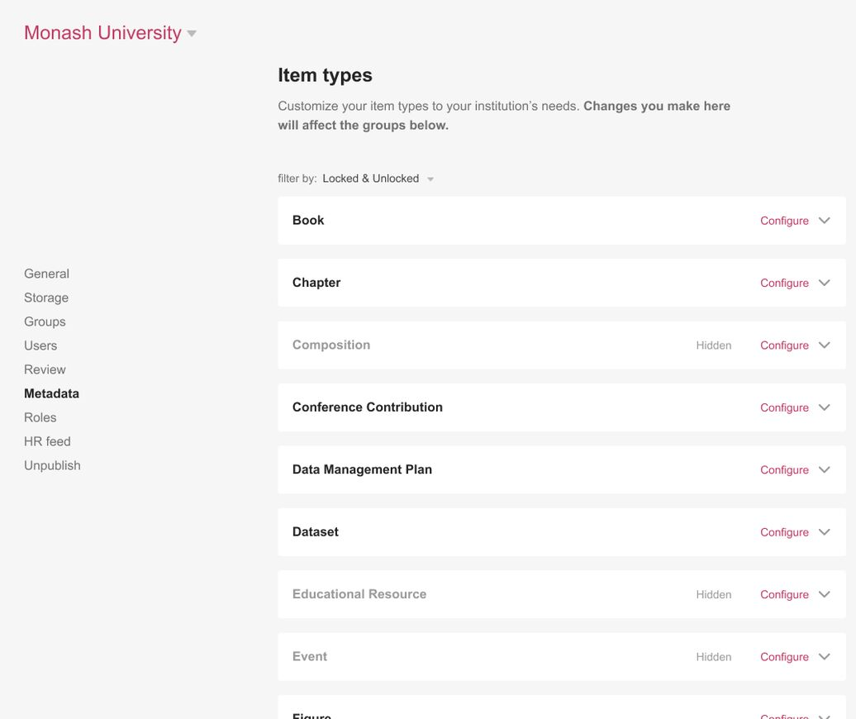
Custom Item Types
Notes:
test

Slide 48
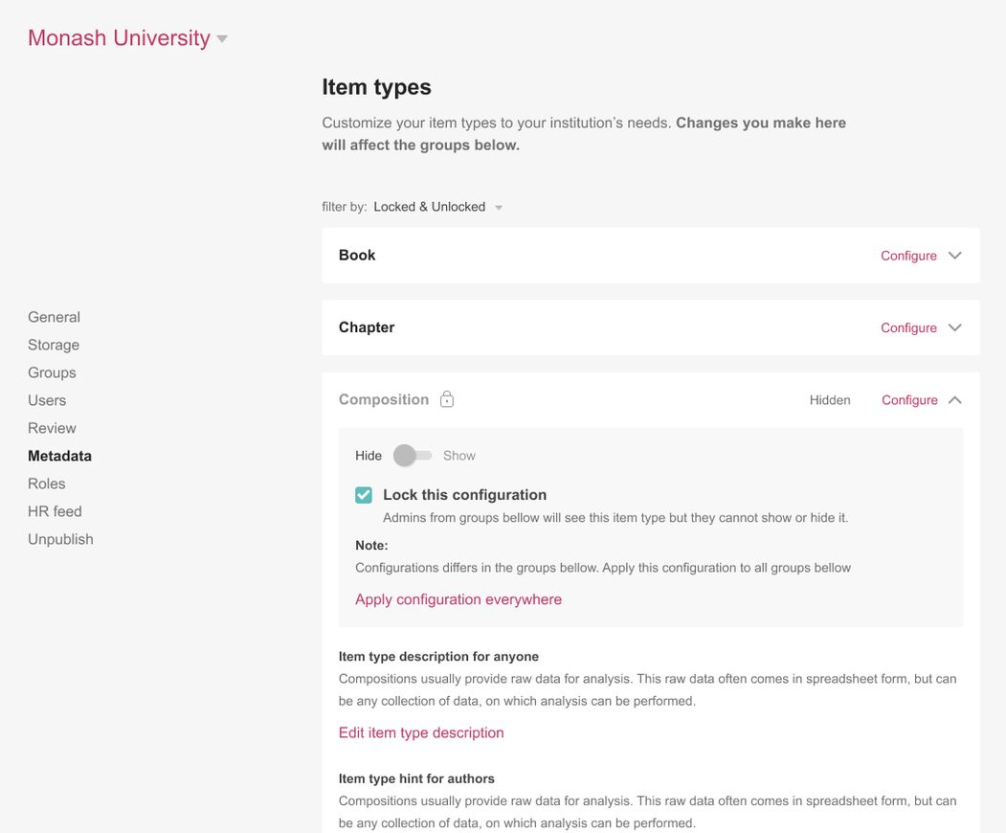
Custom Item Types
Notes:
test

